Slide 1


Gender Inclusion in Science
Kristina Lerman | Information Sciences Institute, Department of Computer Science
Goran Muric | Information Sciences Institute
Ninareh Mehrabi | PhD CS, Fall 2018
Aditya Gupta | MS CS, Spring 2019
Vineetha Nadimpalli | MS CS, Spring 2020
Ayushi Jha | MS CS, Summer 2019

Slide 2

Gender Puzzle
Analysing Gender Imbalance in the Sciences (via research publications data)
Science Careers
Co-Author Popularity
How does gender career stats differ across their careers, in terms of:
% YoY growth
Career Length
Publishing Rate
Lifetime publications

Does one gender tend to work with more popular co-authors, in terms of:
More Co-author Publications
Higher Academic Age
More contributors in academia

Location , Location, Location
Collaborators
Do certain countries/regions show better gender distribution?
Do authors form some institutions tend to collaborate more?

Does one gender have preference in terms of working with another gender?
Do they tend to work in alone , in smaller groups, or in large groups?


Slide 3



Data and Resources Available
Papers for the dataset have been taken from American Physical Society, with over 600,000 papers from over 100k institutions around the world across many decades.
Attributes of all the papers are provided, such as –
Article id, Title, Publisher, Journal, Issue, Date of Publication, Authors, Institute
With initial observation of 385k male authors and 45k female authors in our dataset, found there to be a low representation of female authors relatively
Female publication data ~10% of Male publication data

Slide 4


Challenges
Unstructured Data (inconsistent names, locations, and gender availability
1
Inconsistent_n@meS
Names with only Abbreviations as first names
Keywords present in data such as and, or
Language-specific names written in English (eg. Hinglish)
Names written in different formats, hyphens, underscores
2
Location, Location, What?
Inconsistency in how names are written
eg: USC written as Univ of SC, USC, Viterbi etc
Output has to be cleaned because length of fields change eg: India, Bengal (State), Kanpur (City), 110007 (Zip Code) etc
3
Male/Female/Not-Found!
Gender not part of data, so identify a good genderizer -> Genderize.io
Genderizers only classifies first name, and names are mostly unstructured, so we are left with less amount of labelled data

Slide 5
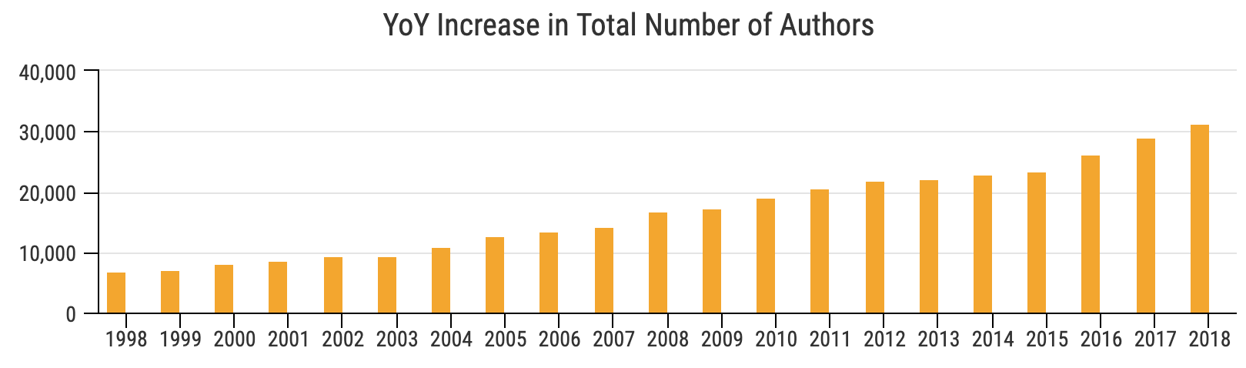
YoY Increase
There is continuous and steady increase in total authors starting from 1900 (data starts). More discernible since 1998.
14%
100 years of solitude (of female domination)
12%
12%
YoY Female increase as % of total population is higher since the early 20th century
1950-1960 was a golden period which saw females increase substantially more YoY
Since year 2000, females have increased at a steady ~10% per year
There were certain peaks in male % increase during 1990s, however women have showed a relatively steady increase, and low yoy variation
7%
10%
8%
>1900
>1950
>2000
M
F
M
F
M
F

Slide 6
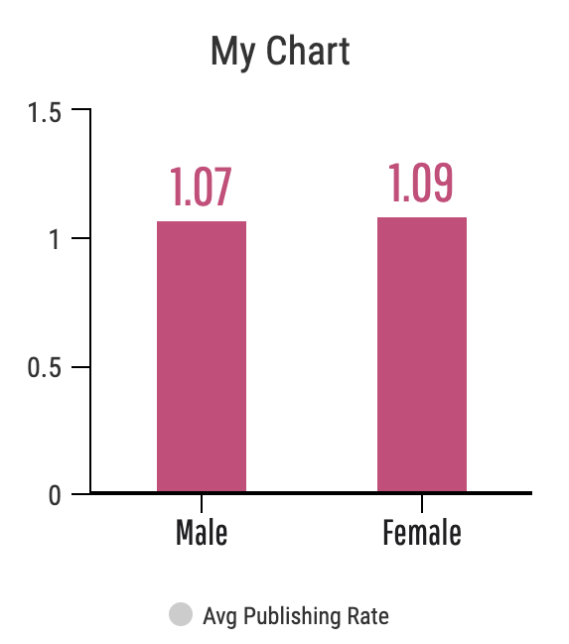

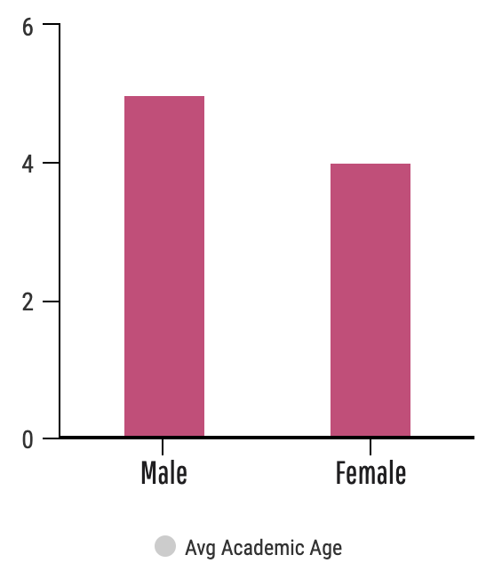
Career Productivity
Total papers in academic lifetime
5.48 years
4.18 years
Average Publishing Rate (Papers/Year)
Papers published per year is almost the same
5.0
Papers
published by males is higher than females
4.0
Hypotheses
Although the publishing rate is almost the same for male and female researchers, male researchers publish 25% more papers in their academic lifetime than females.
Males have a larger career lifetime
Males are more productive than females
Easier for males to publish compared to females
Do males start their careers earlier than females

Slide 7
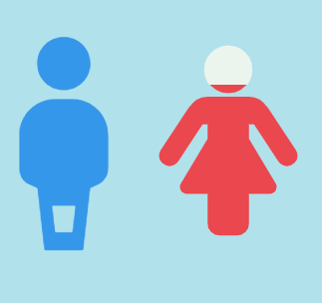
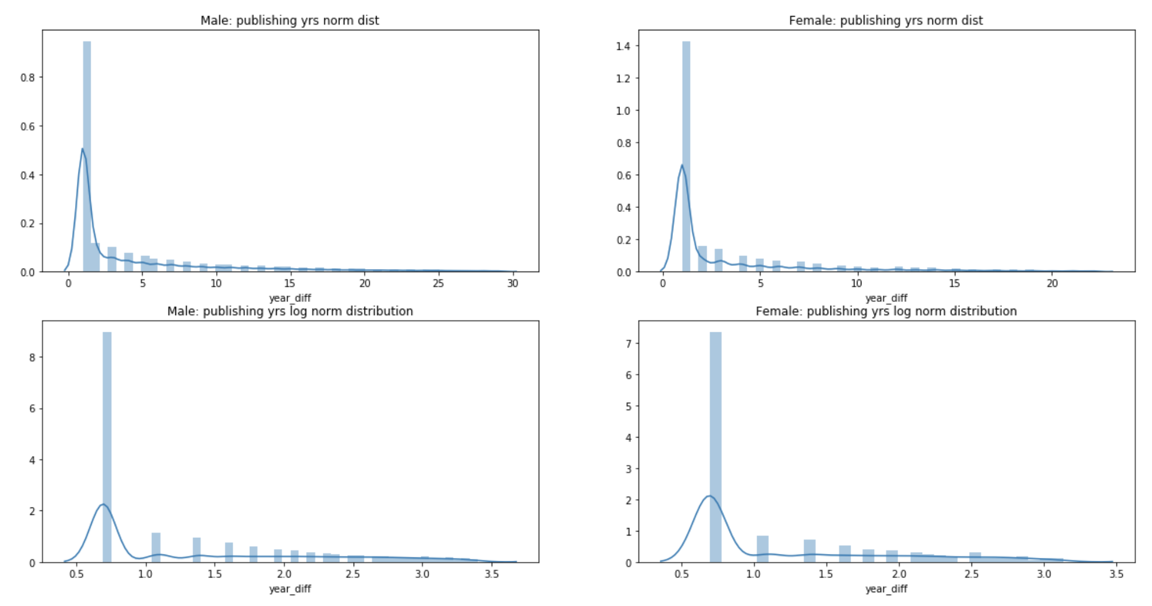
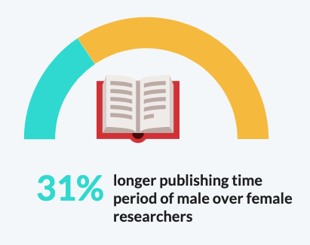
Career Length
Career Lengths = Time Period b/w authors first and last paper i the dataset
5 years
4 years
On the outset, it seems that males enjoy a longer academic career lifetime ~5 years compared to females ~4 years
*Outlier removal at gender level for values above +-3 SD
**For authors who were active/published for a single year, we consider their academic age = 1

Slide 8
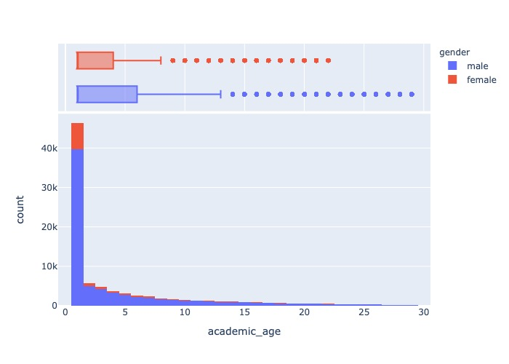
Career Length - 2
Further analyses (Boxplot here, others in appendix) show that not only do females have a very high % of authors active only for 1 year, they also majoritarily have shorter academic lifetimes
% of male authors with higher career lengths is also more than % of female authors (outlier cleaned)
Key Takeaway:
Females despite having similar publishing rate, stay less active in academia
Majority of females have a career length of only 1 year ~60%
Majority of males also have a career length of only 1 year ~53%
*Outlier removal at gender level for values above +-3 SD
**For authors who were active/published for a single year, we consider their academic age = 1

Slide 9



Collaborator Analysis
2.1 avg number of collaborators per paper
Male
Female
2 = average number of male collaborators per paper when BOTH GENDERS present
7 years = average age of male collaborator per paper when BOTH GENDERS collaboratore
3 = average number of female collaborators per paper when BOTH GENDERS present
3 years = average age of female collaborator per paper when BOTH GENDERS
collaboratore
When both genders collaborate together, on average number of female authors is higher than males
When both genders collaborate the average age of male authors tend to be almost twice the average of female authors. So on average across gender collab happens between senior males and relatively junior females. *Caveat: % of females with low ages is also higher
*Only papers where gender info was available for all the authors were considered

Slide 10
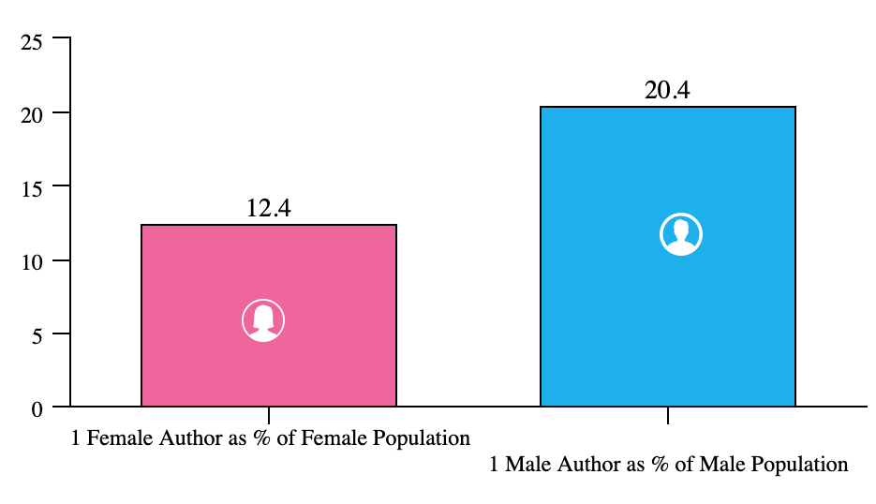
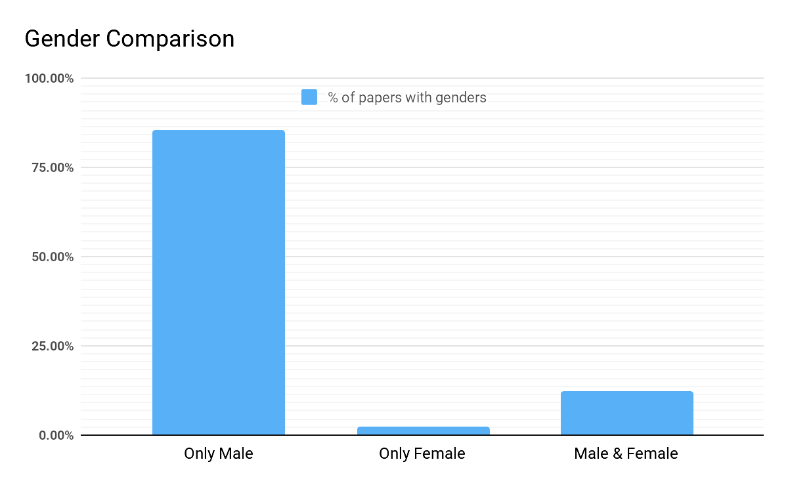
Collaborator Analysis - 2
We saw earlier that females tend to have shorter publishing career length compared to males.
Here we see that when they are active, they usually work in groups (group size analysis in Appendix), as only 12% of female authors chose to publish as single author.
Males tend to go at it alone more, comparatively speaking.
20%
12%
% of papers with ONLY FEMALE authors: 2.31% papers
% of papers with ONLY MALE authors 85.28% papers
% of papers with BOTH MALE & FEMALE authors: 12.41% papers
In total population Males far outweigh women at single author papers. Both gender papers are also more common than only female author papers.
*Only papers where gender info was available for all the authors were considered

Slide 11
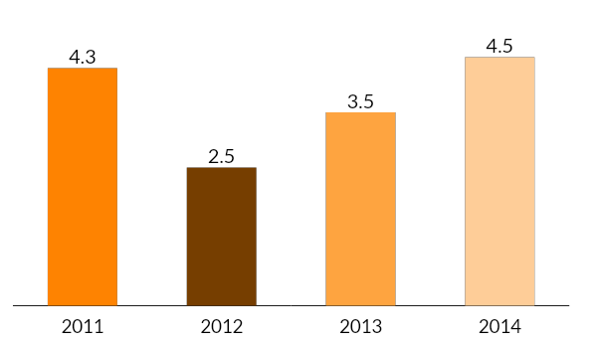
Co-author Popularity
Comparing ‘popularity’ of Co-authors of both genders:
Average academic lifetime of of co-authors of females and males is largely similar. Which sounds counterintuitive as females display shorter academic lifetimes, but make as when they do collab the average age is higher. (For distribution as opposed to avg, see Appendix)
Average papers published by female co-authors and male co-authors is also largely similar. Which further downplays the prominence/popularity of co-authors of one gender over the other.
14.2
27
14.0
26
VS
Females
Males
Females
Males
Years
Papers
Average papers published by co-authors
Average academic age of co-Authors

Slide 12

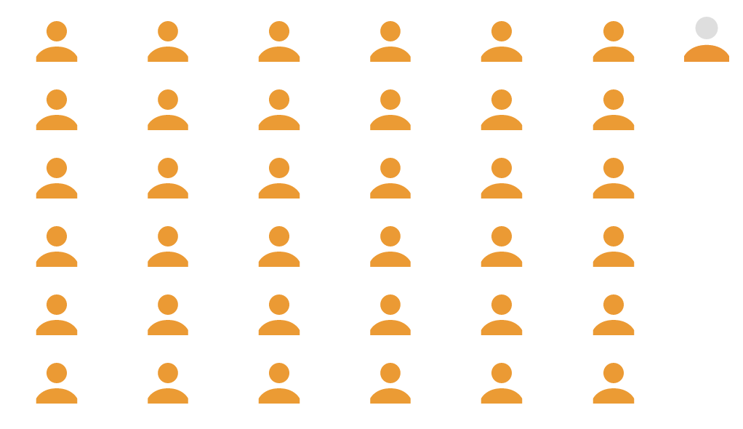
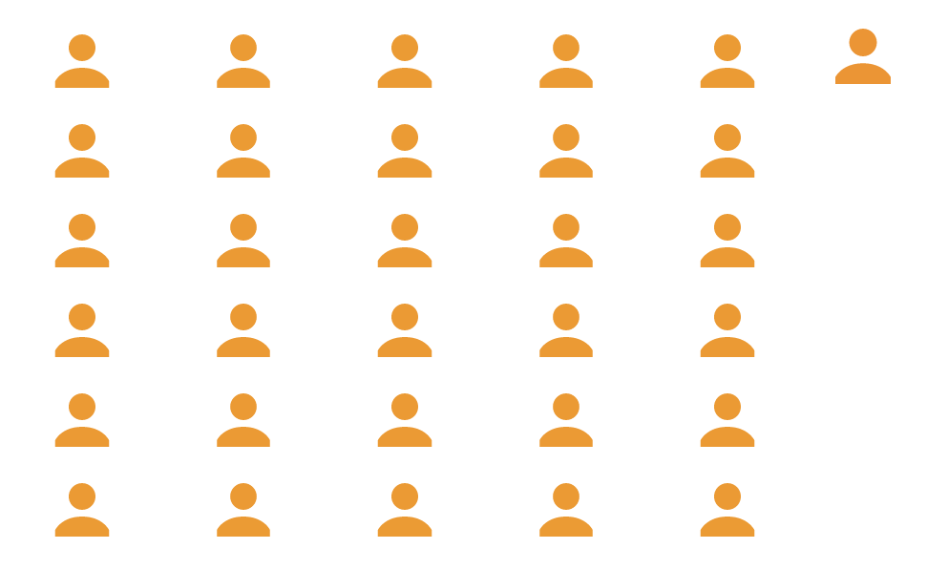
Co-author Popularity - 2
Hypothesis: There is gender imbalance in terms of total lifetime co-authors of male and female co-authors
Co-authors of females, on average work with 37 other authors in their academic lifetime.
Co-authors of males work with on average 31 other authors over their academic lifetime.
Females show a trend where they tend to work with more ‘collaborative’ authors as opposed to male authors.
Caveat: % of male single author papers is very high, and thus afects the overall results.
Female Author
Male Author
Co-Authors
Co-Authors
37 lifetime collaborators
31 lifetime collaborators

Slide 13
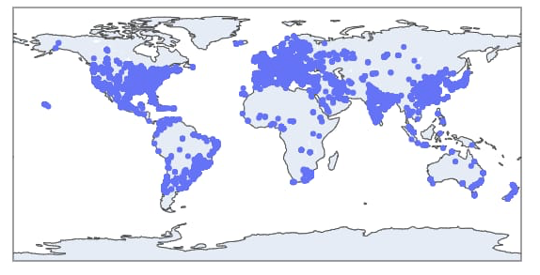
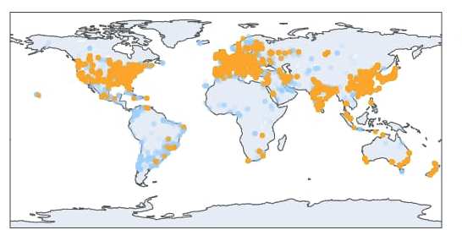
Location Analysis
Unique Institutions Across the World
Institutions with female authors across the world
Many institutions still do not have significant female population

Slide 14
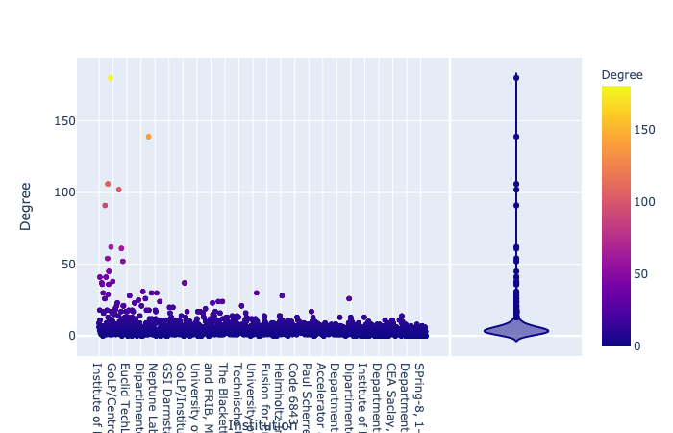
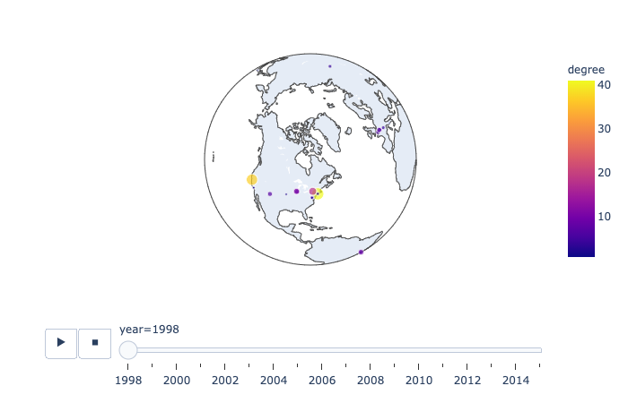
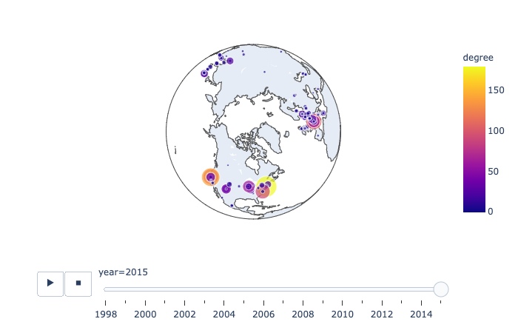
Degree Collaboration
Hypothesis: Do we see a change in cross-region/institution level collaboration across time
Collaborations between institutions show an exponential increase over time, both in terms of the number of institutes and the amount of collaboration per institution per year.
There are few institutes which are extremely collaborative, and hence cause the long tail in the box plot. They have 150+ collaborations, whereas the average is ~5. CERN, Berkeley, Los Alamos, are the usual suspects.

Slide 15
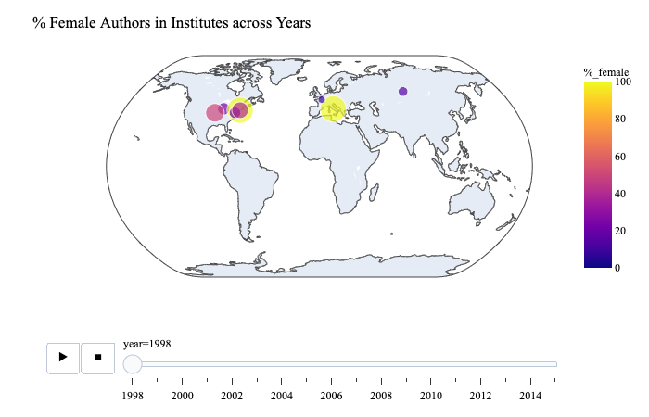
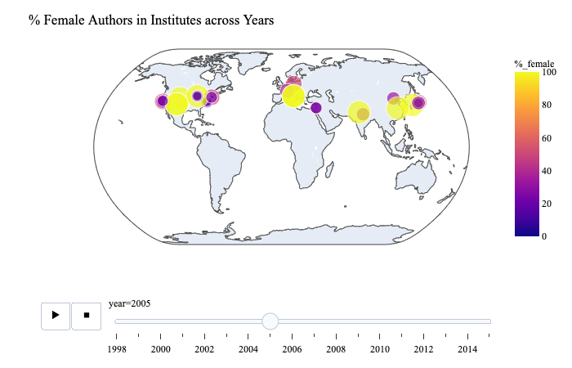
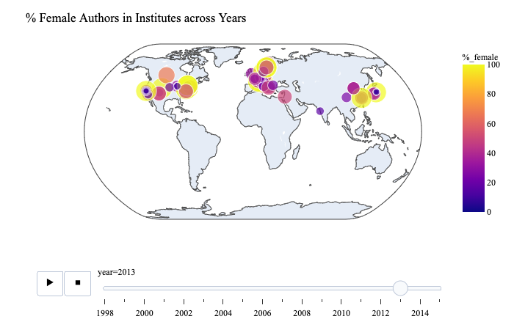
% Gender Change
Hypothesis: Do we see a change in % of female author increase over the years
Over time we see an clear and distinct increase in % of female population YoY
There is higher % and absolute increase in Western and European countries

Slide 16
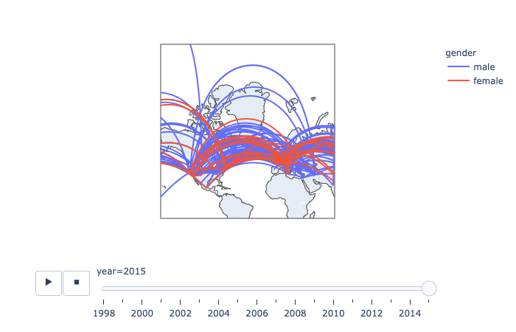
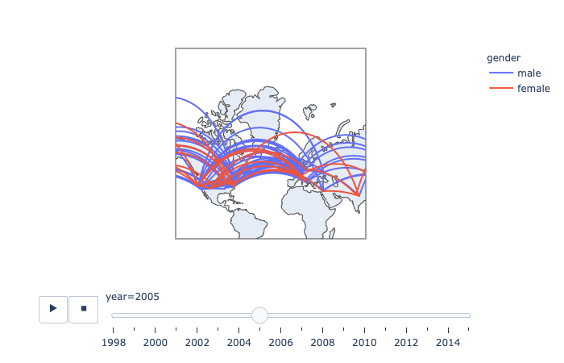
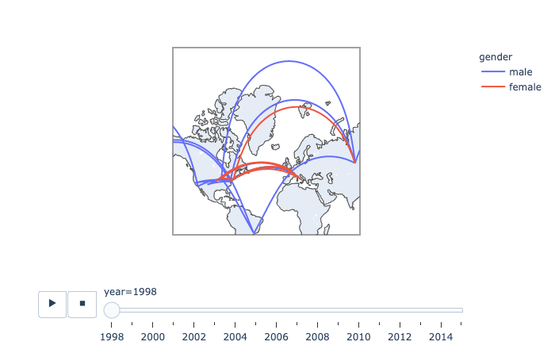
Institute Collaboration
Hypothesis: Collaboration across institutions by gender over the years
The % increase in collaboration in female authors is lower than the increase in male authors. Also, female authors increase over time faster than their rate of collaboration.
Transcontinental and overall across-country collaborations increase at a linear rate over time

Slide 17
Key Takeaways
Co-author average papers across academic lifetime is same across genders
Co-author average academic age is same across genders
Females tend to work with co-authors, who themselves work with larger number of authors compared to males
Majority institutions in the word still have very low to none female % population
Western and European countries have higher female population
Western countries have higher female-to-male ratios
Western country authors how higher degrees of collaboration
Gender Stats
Popularity
Co-Authors
Location
YoY increase in female population is higher than males
Overall female population is very low compared to males
Publishing rate is same across genders
Males have more lifetime papers published
Males have longer publishing career length
Males tend to work alone more compared to females
Females when collaborate, collaborate highly
Average author ages of female co-authors is less than males

Slide 18
Future Steps
✶


1. Institution Level Deep Dive
2. Network Analysis
3. Age, Popularity, Productivity...
Which institutes show higher colab
What are the total author metrics for those institutes
Do low male-female ratio institutes display different publishing behaviour compared to high ones
Does the overall academic career length of authors affiliated to some institutes show a trend
Which institutions are popular?
Which authors are popular
Which authors drive collaboration across lifetime
When does collaboration increase, at what age
In which institutions has there been an increase/decrease in female authors?
Distribution of less popular and more popular authors (wrt frequency of collaborations, papers published),
What is the dropout age for most authors of both gender?
How does metrics differ across an author's academic age

Slide 19
Thank You

Slide 20
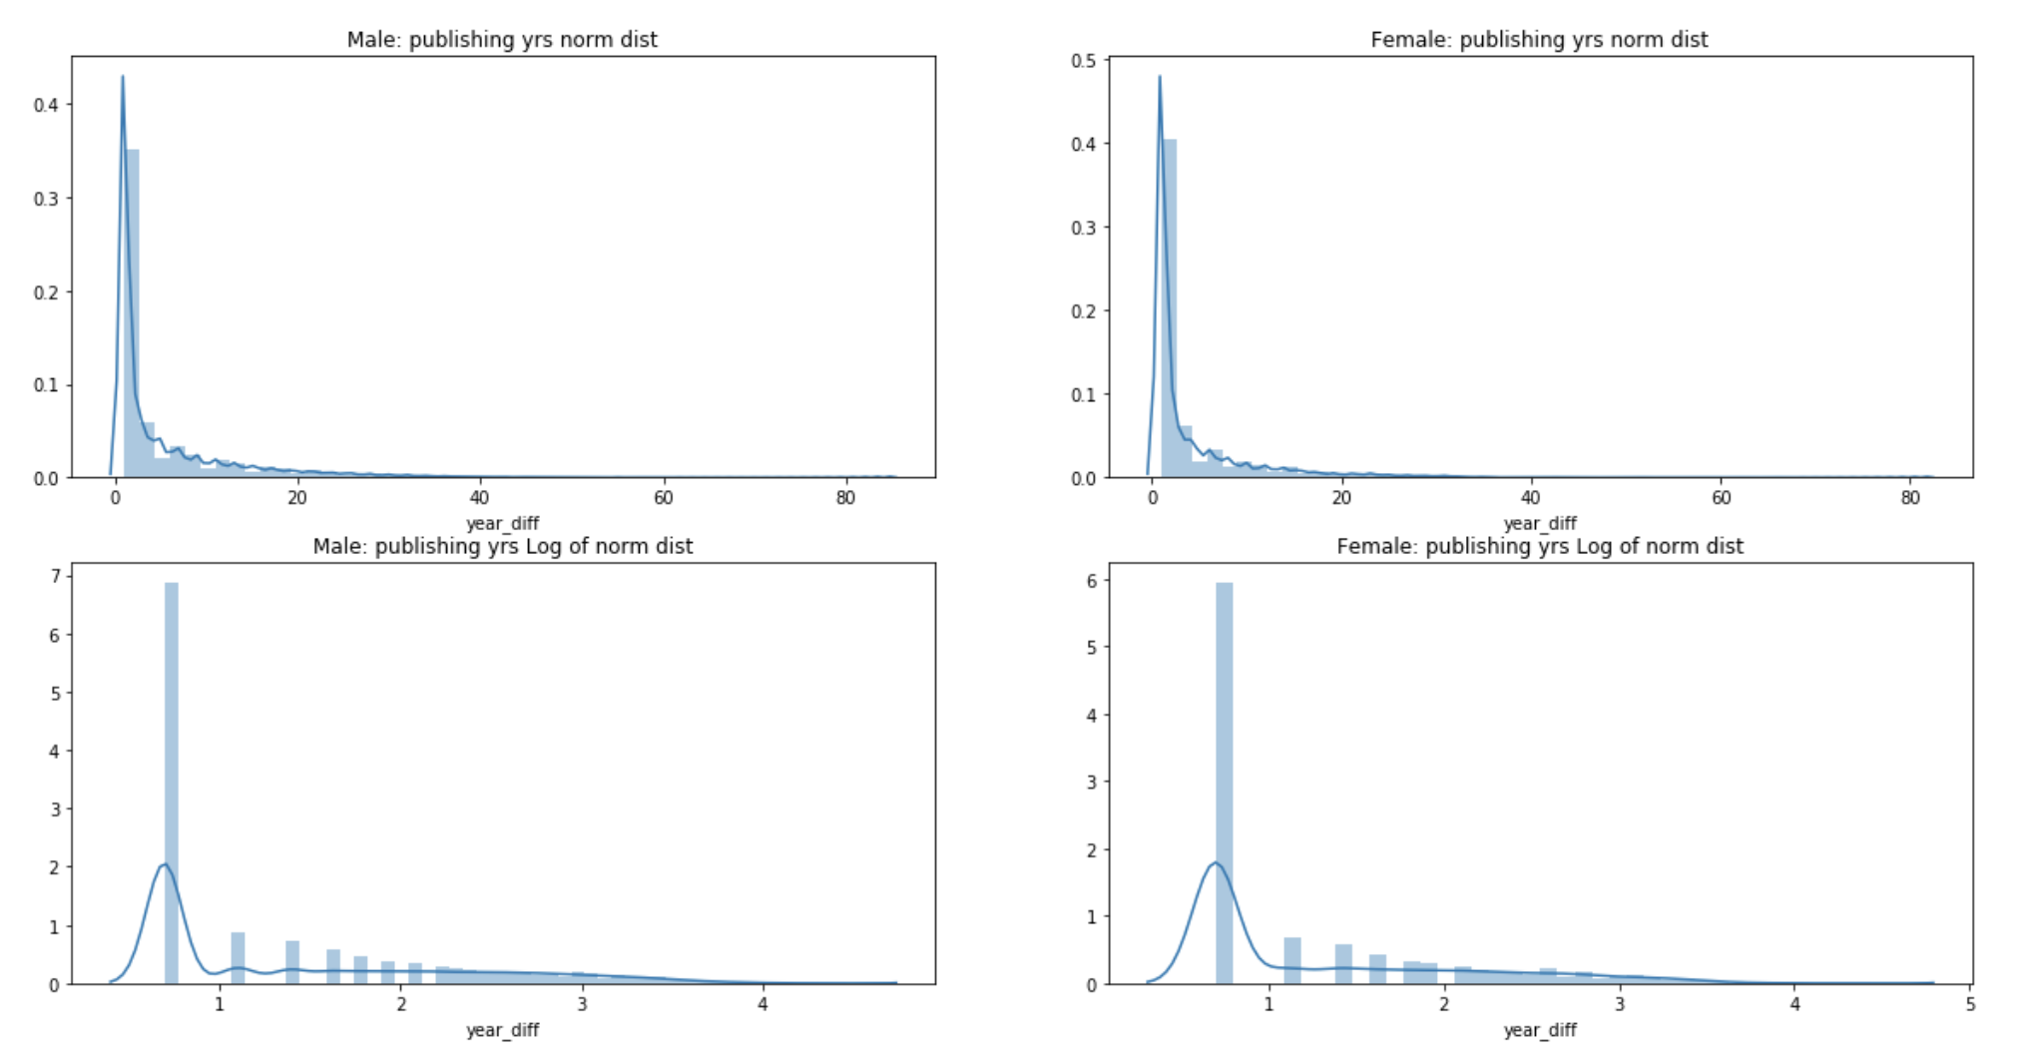
1.1 Appendix
Normal Distribution:
Distributions of how male and female genders publish over their career lengths.
Insight:
Majority of authors publish between 1-3 years (% of Authors with career length = only 1 yr: 52.4%)
QUANTITATIVE ANALYSIS
TEMPORAL ANALYSIS
Quantify a gender imbalance in academia at various levels
Observe the temporal pattern of gender distributions
Which countries are most welcoming for female researchers?
Which institutions in the world have the least gender imbalance?
Which STEM schools have the most balanced research staff?
Methodology:
Find lowest year and highest year of publishing at name-gender level data
Take difference between years (max_year - min_year)
Design Choice: For authors with only a single paper, eg: Only 1 paper in 2002, the difference would be = 0, therefore we assume that each paper means the author was active/published in that year or even for 1 paper the diff b/w max and min year = 1 Time diff = max_year - min_year + 1
Mean(Time Diff) for Male and Female Authorsssstitutions/disciplines?
Which country has the greatest change?

Slide 21
1.2 Appendix
Pre-Processing
The first challenging task before starting analysis on the dataset was to classify the names into genders as the dataset didn’t have any gender labels.
The dataset was cleaned and preprocessed by removing ambiguous author names such as those consisting of only initials.
Each paper and its authors had associated year of publication and institution respectively. For location-based analyses, the name of the institution is the only source of location.
We first need to normalize the names as institutions could be written in different ways generating slightly different latitudes and longitudes from the location APIs such as Google Geocoder.
Performed exploratory data analysis to answer questions such as how the ratio of female to male publishers has changed over the years, how gender plays a role when looking at collaborative efforts across multiple institutions, and any other information that could help us establish whether the support or lack thereof provided by institutions shapes the research careers of women in scientific areas, or alternatively help us uncover interesting patterns in our data.
For the purposes of our analyses, the libraries and languages we have used include Python, Genderize.io API, pandas, Google geocoder API.

Slide 22
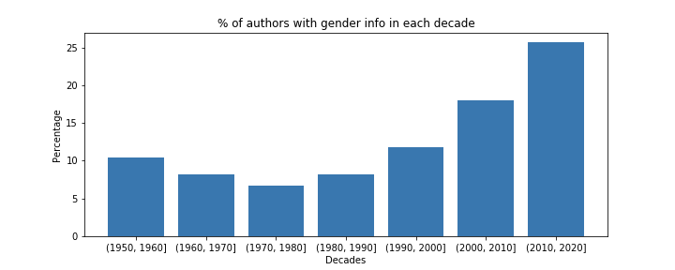
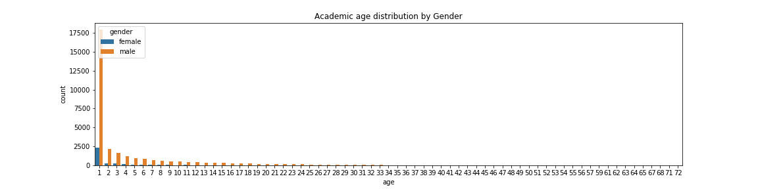
1.3 Appendix
Moving Window Analysis
Q: Does gender info for authors change over decades?
A: Higher % of authors (~25%) have gender info for recent decades, compared to previous decades (10% for 1950-1960)

Slide 23
Age Analysis
1.4 Appendix
Avg Overall Age: 5 years
Males
Females
Avg academic age = 5.1 years
Avg academic age = 3.7 years
Collaboration
Males
Females
Avg male age in [m-f, m-m, m] = 14.2 years
Avg female age in [m-f, m-m, m] = 0.5 years
Avg male age [m-f, f-f, f] = 6.3 years
Avg female age [m-f, f-f, f] = 5.0 years
ONLY Male Authors [m-m, m] = 15.2 years
ONLY Female Authors [f-f, f] = 11.5 years
85.3% of total data
2.3% of total data
12.4% of total data
BOTH Authors [m-f] = 7.5 years
BOTH Authors [m-f] = 3.8 years

Slide 24
Collaboration Analysis
1.5 Appendix
Avg Overall # Collaborators = 2.0 Authors
Males
Females
Avg #collabs in [m-f, m-m, m] = 2.0 authors
Avg # collabs in [m-f, f-f, f] = 2.8 authors
ONLY Male Authors [m-m, m] = 1.8 authors
ONLY Female Authors [f-f, f] = 1.1 authors
85.3% of total data
2.3% of total data
12.4% of total data
BOTH Authors [m-f] = 3.1 authors
Next Steps: Collate results across a paper or a Github blog

Slide 25
1.6 Appendix
2 Author & >=3 Author Analysis
2 Author - % of papers with ONLY FEMALE authors/collaborators: 0.71% papers
2 Author - % of papers with ONLY MALE authors/collaborators: 84.96% papers
2 Author - % of papers with BOTH MALE & FEMALE authors/collaborators: 14.33% papers
>=3 Author - % of papers with ONLY FEMALE authors/collaborators: 0.12% papers
>=3 Author - % of papers with ONLY MALE authors/collaborators: 70.94% papers
>=3 Author - % of papers with BOTH MALE & FEMALE authors/collaborators: 28.94% papers
% of papers with ONLY FEMALE authors/collaborators: 2.31% papers
% of papers with ONLY MALE authors/collaborators: 85.28% papers
% of papers with BOTH MALE & FEMALE authors/collaborators: 12.41% papers

Slide 26
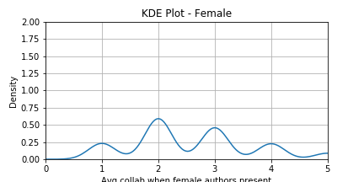
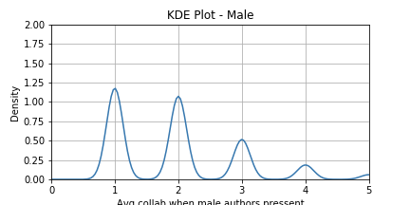
1.7 Appendix
Collaborations
Overall: Average number of collaborators per paper: 2.01
Females: average number of collaborators per paper: 2.80 authors
Males: average number of collaborators per paper: 2.03 authors
Males: average number of collaborators per paper when ONLY males collab: 1.88 authors
Females: average number of collaborators per paper when ONLY females collab: 1.13 authors
% of papers with ONLY FEMALE authors/collaborators: 2.31% papers
% of papers with ONLY MALE authors/collaborators: 85.28% papers
% of papers with BOTH MALE & FEMALE authors/collaborators: 12.41% papers
Obsv: Females collaborate when overall collaboration on paper is high TODO: Investigate further
Methodology:
Data PK: Paper Id | Columns: Count of authors, count of male authors, count of female authors
Avg collab = mean(count of authors)
Avg female/male collab per paper = mean(count of female/male authors)
Avg female ONLY collab per paper = mean(count of authors in table at lvl: count of female > 0 & count of male == 0)

